Slide 1
What maths looks like at St Margaret’s
And how you can help at home ☺

Slide 2
This is our philosophy
Everyone can learn maths. We encourage a growth mindset.
Mastery approach to learning where children’s understanding is deepened
Concrete, Pictorial, abstract (CAP) approach to ensure a solid understanding
Problem solving and reasoning takes place in every objective
We make cross curricular links wherever possible

Slide 3
What maths looks like in our school:
Access to manipulatives/concrete resources to support understanding
Flexible mixed ability groupings for some lessons which allows children to work with different children and to ensure challenge
Lots of talk and reasoning
Problem solving throughout
Opportunities to practise and become fluent in calculation methods
Mini-plenaries to share misconceptions, pose questions, challenge ideas

Slide 4
How does it work?
Structured problems which challenge thinking and allow children to expose patterns and opportunities for “making connections”
In some lessons, children choose their own entry point to challenge themselves. All challenges are linked, promoting the mastery approach.
Focus on specific mathematical language, especially when explaining why.
Regular links to “real world” maths
Regular practice of times tables through chanting, singing and games
Many opportunities to talk mathematically
Reasoning activities such as : True/False, Prove It, Always, Sometimes, Never.

Slide 5
When needed, children are given time to review a task in the following session or later that day. Sessions are fluid and intervention is rapid.
Children evaluate their work using the red and green boxes which informs use of intervention along with marking and assessment during the lesson.
Teachers may pre-teach a concept ahead of the lesson too, to help build confidence or enable children to access the lesson

Slide 6
Where are we heading?
By the end of year 2
Using numberlines to develop understanding of:
Counting on in tens and ones
23 + 12 = 23 + 10 + 2
= 33 + 2
= 35

Slide 7
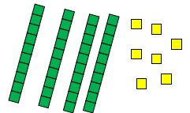
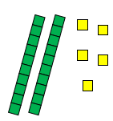
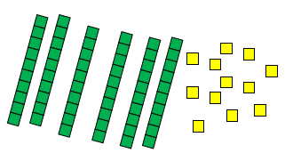
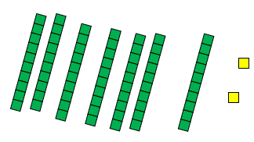

Towards a Written Method
Partitioning in different ways and recombine
47+25
47 25 60 + 12
Leading to exchanging:
72
Expanded written method
40 + 7 + 20 + 5 =
40+20 + 7 + 5 =
60 + 12 = 72

Slide 8
34 Adding in columns, no regrouping
12 +
46

Slide 9
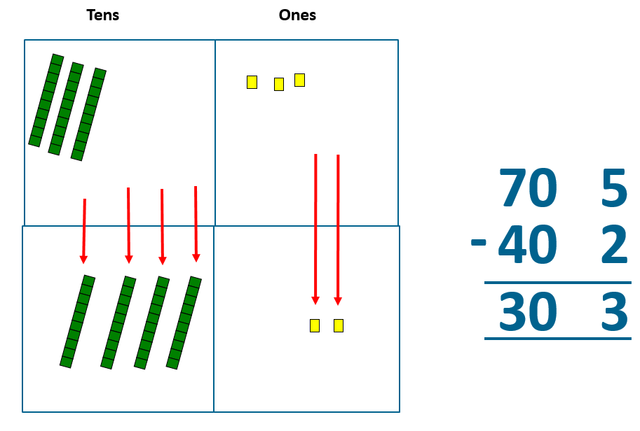
Subtraction
Towards written methods
Recording addition and subtraction in expanded columns can support understanding of the quantity aspect of place value and prepare for efficient written methods with larger numbers. The numbers may be represented with Dienes apparatus. E.g. 75 – 42

Slide 10
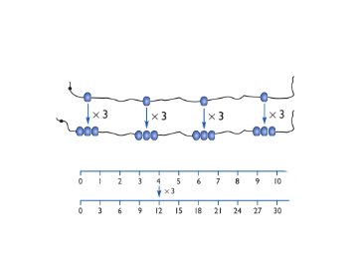
Multiplication
Doubling numbers up to 10 + 10
Link with understanding scaling
Using known doubles to work out double 2 digit numbers
(double 15 = double 10 + double 5)
Towards written methods
Use jottings to develop an understanding of doubling two digit numbers.
16
10 6
x2 x2
20 12
Should know their 2, 5, 10 times tables

Slide 11
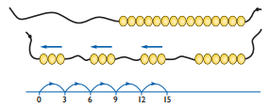
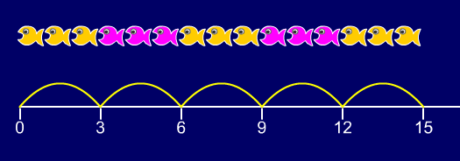
DIVISION
Grouping using a numberline
Group from zero in jumps of the divisor to find our ‘how many groups of 3 are there in 15?’.
15 ÷ 3 = 5
Continue work on arrays. Support children to understand how multiplication and division are inverse. Look at an array – what do you see?

Slide 12
Year 4
Children should know ALL of their times tables by the end of year 4 and how to use the inverse (division) facts.
TT Rockstars
Songs (Youtube- Mr De Maio)
Skip counting as a first step

Slide 13
By the end of year 6
Written formal methods of calculation
Taught in steps so children understand the process,
not just copy it

Slide 14
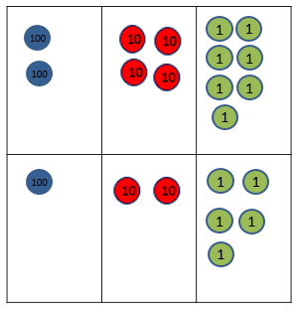


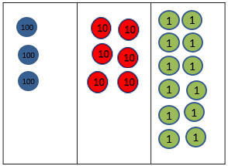
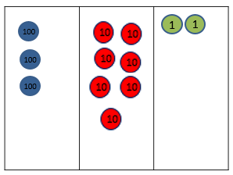
Towards a Written Method
Leading to children understanding the exchange between tens and ones.

Slide 15
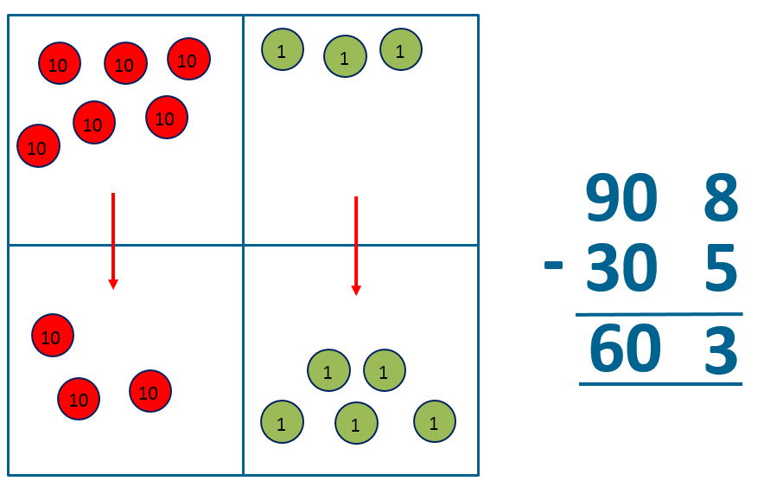
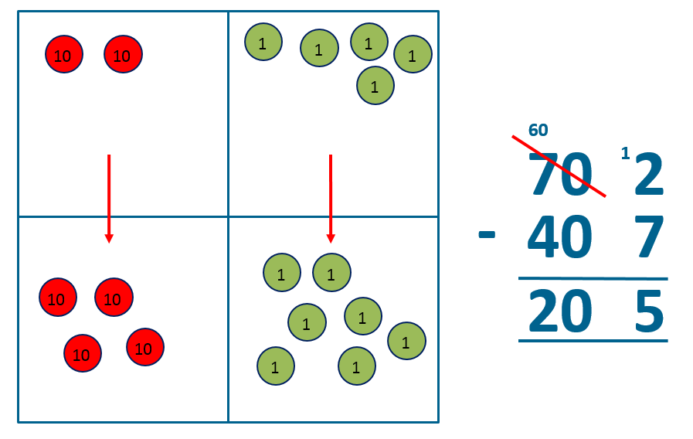
Written methods (progressing to 3-digits)
Introduce expanded column subtraction with no decomposition, modelled with place value counters (Dienes could be used for those who need a less abstract representation)
Leading to
exchanging
6
1
72
-47
25
Leading to formal, compact
method with exchanging.

Slide 16
Written methods (progressing to 3d x 2d)
Children to begin column multiplication, beginning with 2digit numbers by 1 digit numbers. By end of year 6, working with much larger numbers.
34 x 3
34
X 3
12
+ 90
102
34
X 3
102
x | 30 | 4
3 | 90 | 12
1
90
+12
102
Use grid method to explore why this works- a focus on place value

Slide 17
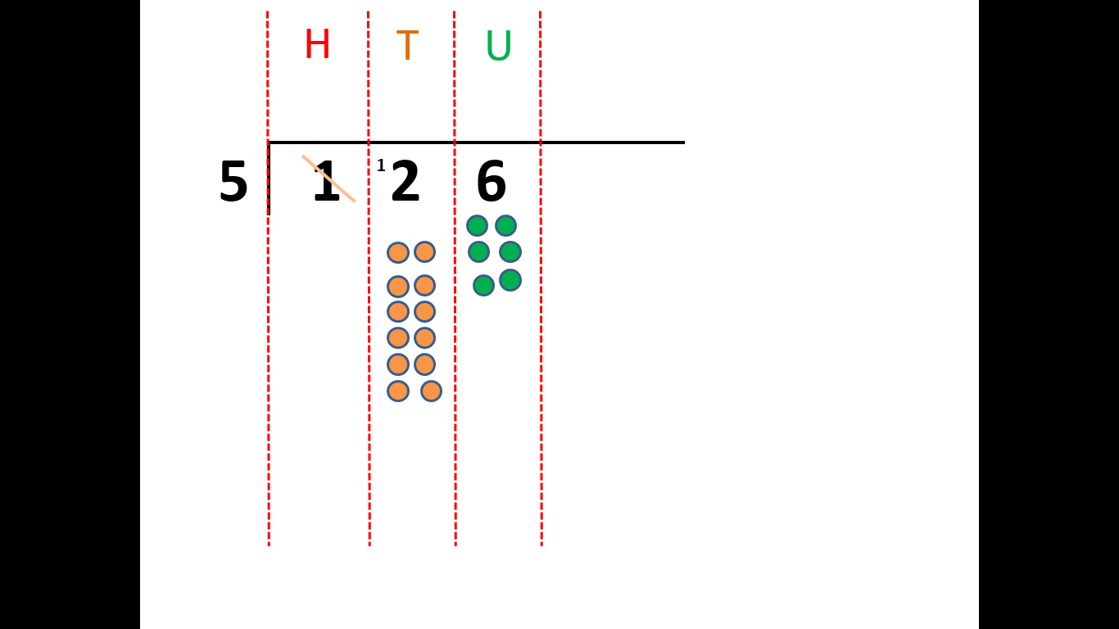
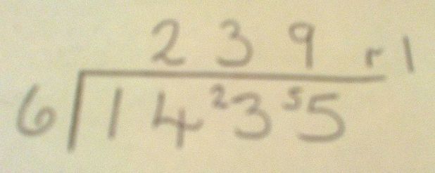
Year 3/4
Formal Written Methods
Formal short division should only be introduced once children have a good understanding of division and its links with multiplication.
Short division to be modelled for understanding using place value counters as shown below. Calculations with 2 and 3-digit dividends.
2
5
r1
2
Year 5 and 6
Children begin to practically develop their understanding of how express the remainder as a decimal or a fraction. Ensure practical understanding allows children to work through this (e.g. what could I do with this remaining 1? How could I share this between 6 as well?)

Slide 18
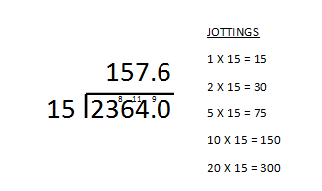
Year 6
Formal Written Methods – long and short division
Children to produce jottings or “Magic Multiplication Facts” to aid their work and to reinforce the link to multiplication.
Children to also represent remainders as a decimal.

Slide 19
How can you help?
Mathematical Talk
Pattern spotting, true or false, Convince me, answering in full sentences, find a rule, create your own problem, spot the mistake, what’s the same- what’s different? Predicting, shape and space, puzzles, left and right, estimating.
http://www.familymathstoolkit.org.uk/
https://www.oxfordowl.co.uk/for-home/advice-for-parents/
If you’re stuck- don’t be shy ☺

